Slide 1
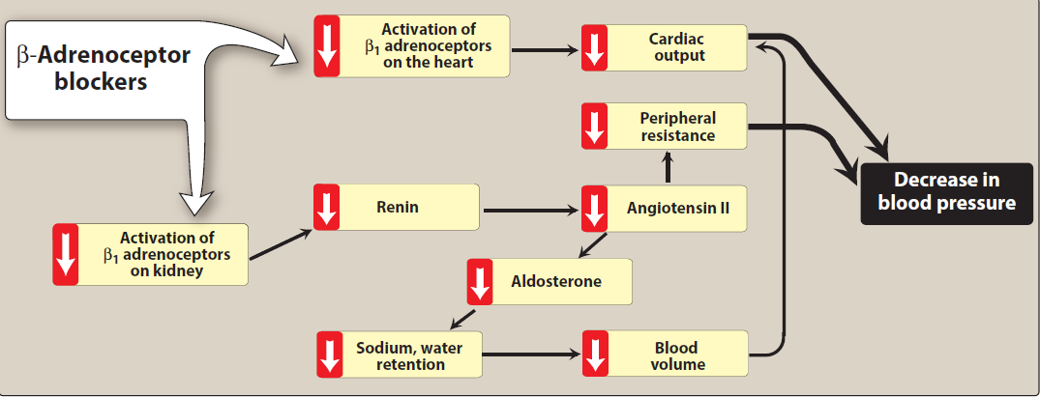

Slide 2
Angiotensin-converting enzyme inhibitors
enalapril, lisinopril, lower blood pressure by reducing peripheral vascular resistance.
These drugs block the enzyme ACE which cleaves angiotensin I to form the potent vasoconstrictor angiotensin II.
ACE break bradykinin a potent vasodilator that work by stimulation release of nitric oxide and prostacycline.

Slide 3
ACE break bradykinin a potent vasodilator that work by stimulation release of nitric oxide and prostacycline.

Slide 4
Vasodilation of both arterioles and veins occurs as a result of decreased vasoconstriction (from diminished levels of angiotensin II) and enhanced vasodilation (from increased bradykinin).
ACE inhibitors also decrease the secretion of aldosterone, resulting in decreased sodium and water retention.

Slide 6
Pharmacokinetics
ACE inhibitors are orally bioavailable as a drug or prodrug.
All but captopril and lisinopril undergo hepatic conversion to active metabolites.
Fosinopril is the only ACE inhibitor that is not eliminated primarily by the kidneys and does not require dose adjustment in patients with renal impairment.

Slide 7
Therapeutic uses
1.Treatment of hypertention, heart failure, hypertensive patients with chronic kidney disease, and coronary artery disease.
2. ACE inhibitors slow the progression of diabetic nephropathy so used in patients with diabetic nephropathy.
3. Treating patient following a myocardial infarction.

Slide 8
Adverse effects
hypotension can occur after initial doses.
hyperkalemia, dry cough sometimes accompanied by wheezing, and angioedema.

Slide 9
3. Calcium channel blockers
calcium channel blockers reduce peripheral resistance and blood pressure.
Verapamil, diltiazem, and the dihydropyridine family are all equally effective in lowering blood pressure.
inhibition of calcium influx into arterial smooth muscle cells.

Slide 10
dihydropyridines as amlodipine, nifedipine, have a greater ratio of vascular smooth muscle effects relative to cardiac effects.
Nondihydropyridine as diltiazem and verapamil.
Nifedipine and the other dihydropyridine agents are more vasodilators and have less cardiac depressant effect than verapamil and diltiazem.

Slide 11
Verapamil has the greatest depressant effect on the heart and may decrease heart rate and cardiac output. Diltiazem has intermediate actions.
The calcium channel blockers are orally active agents and are characterized by high first-pass effect, high plasma protein binding, and extensive metabolism.

Slide 12
Therapeutic uses
CCBs may be used as an initial therapy or as add-on therapy.
They are useful in the treatment of hypertensive patients who also have asthma, diabetes, and/or peripheral vascular disease because unlike β-blockers, they do not have the potential to adversely affect these conditions.

Slide 13
2. All CCBs are useful in the treatment of angina.
3. diltiazem and verapamil are used in the treatment of atrial fibrillation.

Slide 14
Adverse effects
Verapamil and diltiazem should be avoided in patients with heart failure or with atrioventricular block due to their negative inotropic and dromotropic.

Slide 15
Dizziness, headache, and a feeling of fatigue caused by a decrease in blood pressure are more frequent with dihydropyridines (as amlodipine and nifidipine). Peripheral edema is common and gingival hyperplasia may occur.

Slide 16
Centrally acting adrenergic drugs
A. Clonidine
central α2 agonist to produce inhibition of sympathetic vasomotor centers in the brainstem.
This leads to reduced total peripheral resistance and decreased blood pressure.
Adverse effects include sedation, dry mouth, and constipation.
It shouldbe withdrawn slowly if discontinuation is required.

Slide 17
B. Methyldopa
Methyldopa is an α2 agonist that is converted to methylnorepinephrine centrally to diminish adrenergic outflow from the CNS.
The most common side effects of methyldopa are sedation and drowsiness.
It is mainly used for management of hypertension in pregnancy, where it has a record of safety.

